Slide 1
Guess it!
A JAVA Game Project

Slide 2
What is guess it!
Guess It! Project is a game designed in JAVA.
Every Question will be with partial images & user have to guess it.
There is a ID facility for every user.
Keeping and Maintaining the records is not a problem at all.
Scores are given according to the guess time.
It can be further upgraded for extra features.

Slide 3
Various modules :-
Registration Module.
Login Module.
Admin Profile Module.
User Profile Module.
Game Category Module.
Score Module.

Slide 4
Operation
Registration Module: To use Guess It! users are required to register with an authenticated Email ID and unique username. Registration Module for create a new profile. The Fields are mandatory to fill. If user would register successfully, he/she would be asked to log In and choose the topics in which they are interested. After topic selection, Introduction of the topic type game will be shown and game will start.

Slide 5
Operation
Login Module: Login Module provides user to login into their accounts. Users are required to login with their username and password to play Guess It!. User need to login here to play the game. After login, user information will be shown and user can start playing.

Slide 6
Operation
Admin Module: Admin Module is just a User Profile Module but with Database access. Admin can Login with their own generated passwords whenever they would want to update database. Admin can update, delete or renew the database. Admin can also play the game.

Slide 7
Operation
User Profile Module: User Profile module would help user to see his/her scores in every category. User can update his/her profile picture and bio data. User can also change his password to new one if desired. Here on user can play the game.

Slide 8
Operation
Game Category Module: This is the module where User need to choose one category from one of the given category to play the game. This will redirect the user to the introduction and rules of the game and let the user answer the given questions. There will be five question in each category and a hint is provided in every question. User can only use 3 hints in a specific category. At last, user will get redirected to Score Module.

Slide 9
Operation
Score Module: At the end of the game, user will be redirected to the Score Module. Here the total score of the User will be shown and User will get redirected to the User Profile Module to see the updated scores of the user and to play again in other category.

Slide 10
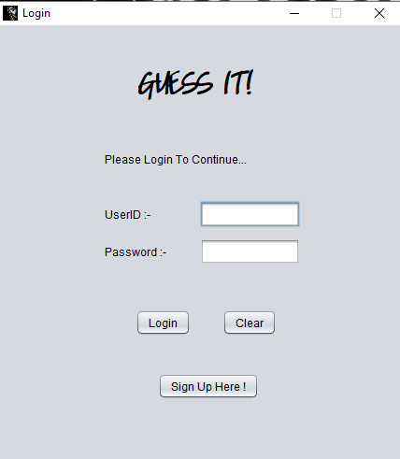
Login module :-

Slide 11
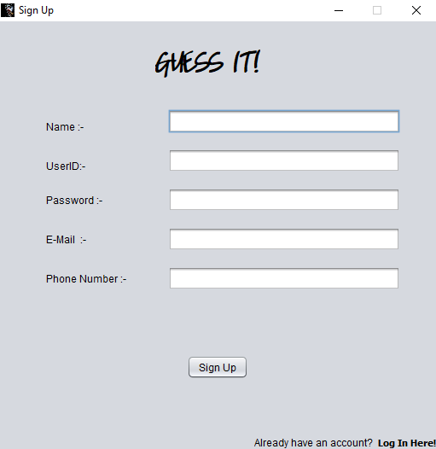
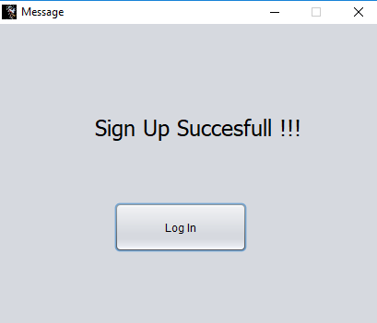
Sign up module :-

Slide 12
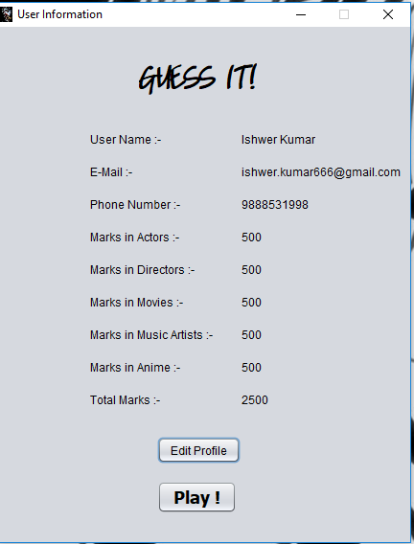
User profile module :-

Slide 13
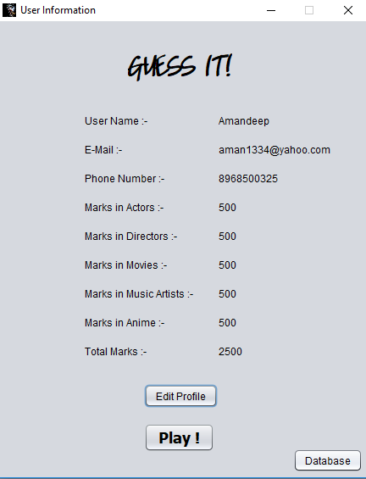
Admin profile module :-

Slide 14
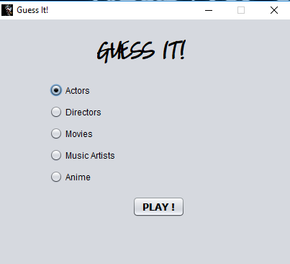
Category module :-

Slide 15
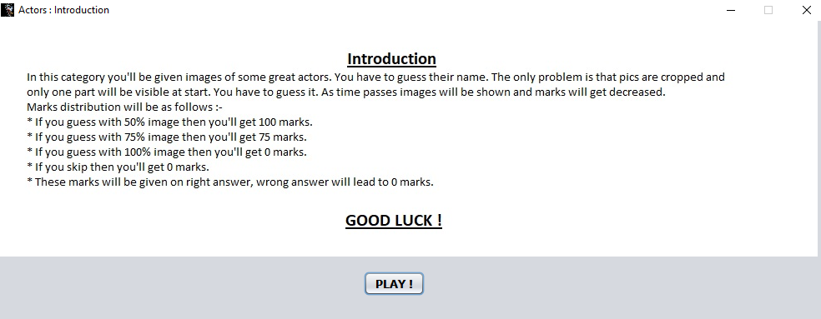
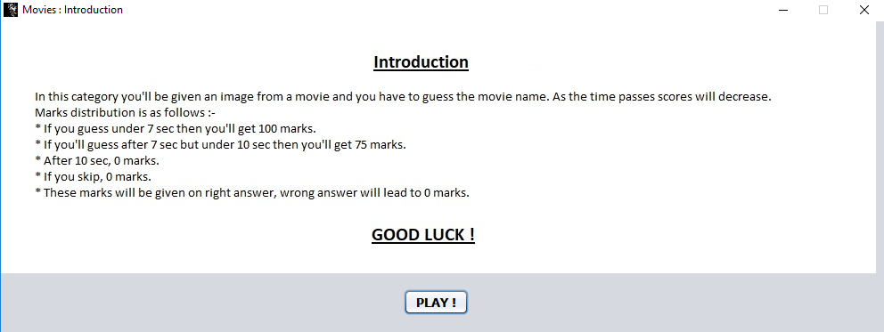
Category introduction module :-

Slide 16
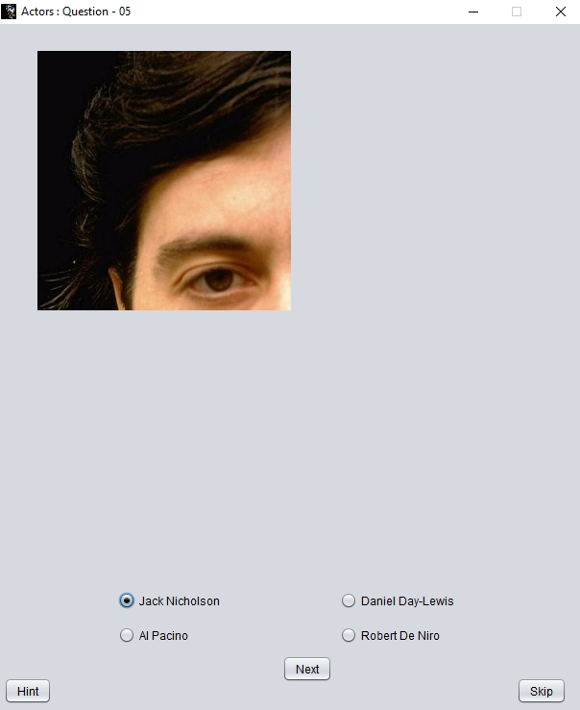
Question modules :-
With full evolution process with respect to time.
Stage 1 :-

Slide 17
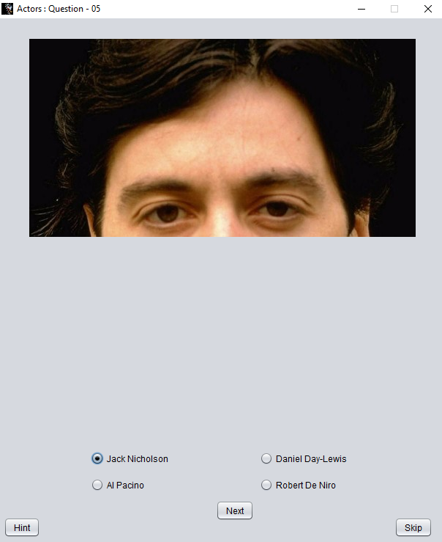
Question modules :-
Stage 2 :-

Slide 18
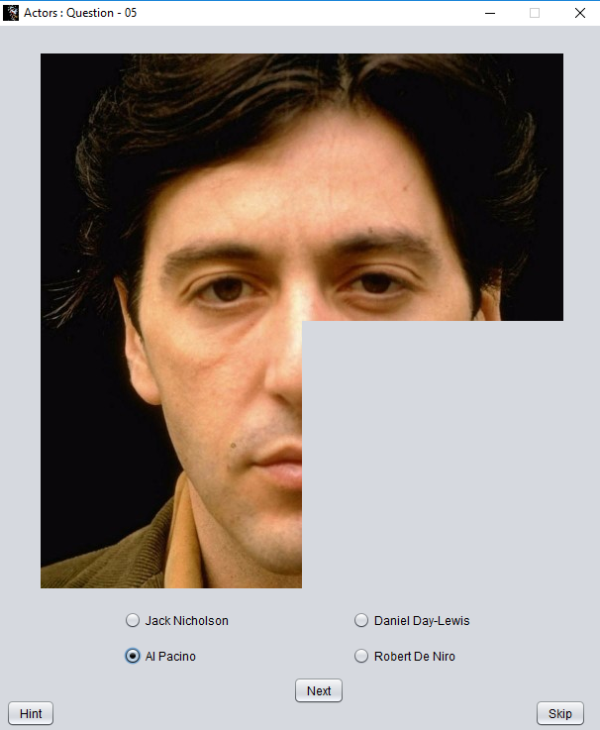
Question modules :-
Stage 3 :-

Slide 19
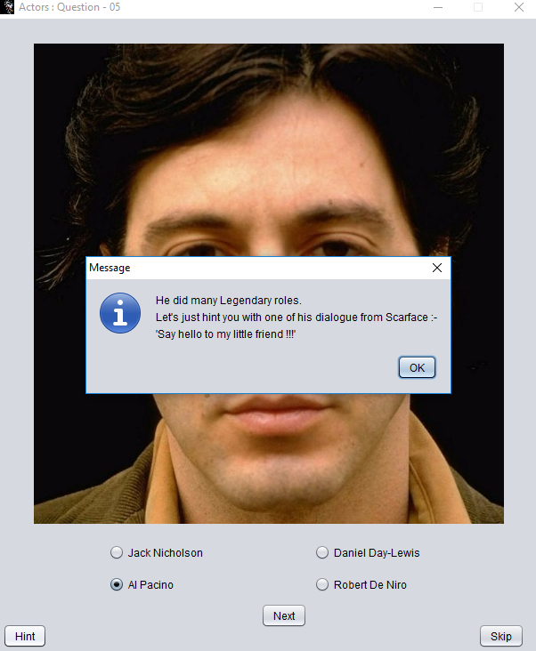
Question modules :-
Stage 4 :-

Slide 20
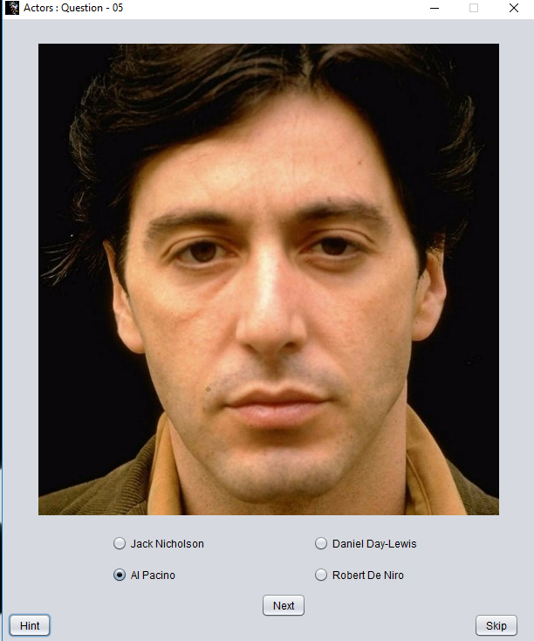
Question modules :-
Stage 5 :-

Slide 21
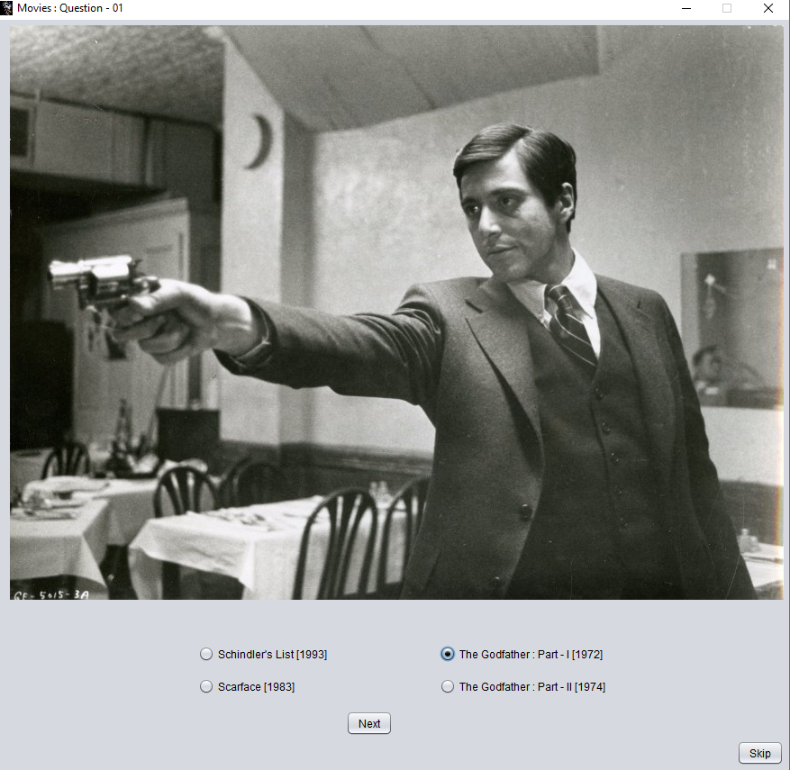
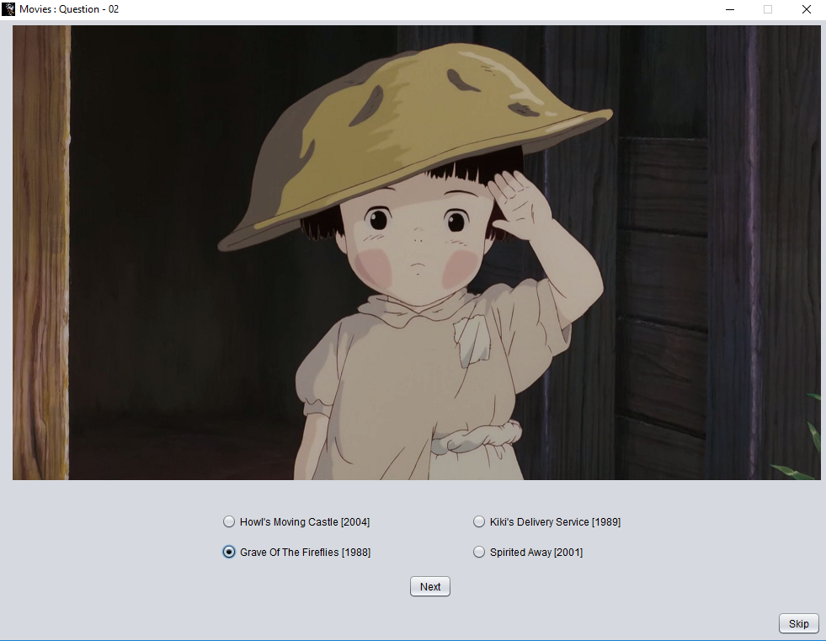
Question modules :-

Slide 22
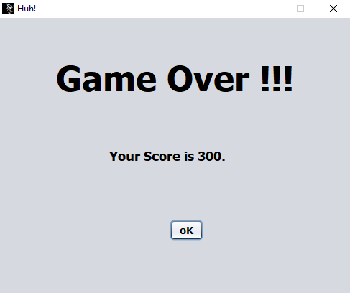
Game over! Module :-

Slide 23
Future scope :-
User should be able to view scores of other users and also challenge them with their own questions.
User can comment on someone’s profile.
Questions can be given or added by user.
Users should also be provided with the feature of chat, so they can communicate with the person whom they follow, and the ones who follow them.
User should also be share their scores on social media like Facebook, Twitter etc.

Slide 24
Thank you!!!
That’s All!

